Slide 1
CHAPTER 9
Immobilization and Microbial Biosensors

Slide 2
Immobilization
The technique of fixing the cells, organelles or proteins onto a solid support system, into a solid support matrix or retained by a membrane, in order to maintain stability and make possible their repeated or continued use.
The early attempts of whole cell immobilization were developed from processes applied to the immobilization of enzymes and generally involved non-viable cells.
Immobilization is extended to viable cells as they were exploited in bioreactors and fermentation systems.

Slide 3
Immobilization of enzymes
The advantages of immobilized enzymes beside reuse are as follows:
They can be easily separated from the reaction mixture containing any residual reactants and reused in subsequent conservations.
Immobilized enzymes are more stable over broad ranges of pH and temperature.
Enzymes are absent in the waste-stream
Immobilized systems specially lend themselves to continuous processes.
Reduced costs in industrial production.
Greater control of the catalytic effect.
Greater ease of new applications for industrial and medical purposes.
Immobilized enzymes permit the use of enzymes from organisms which would not normally be regarded as safe (i.e. non-GRAS).

Slide 4
Strategies of enzyme immobilization

Slide 5
Immobilization of whole cells
Immobilized cells have the following advantages over conventional batch fermentation as well as over immobilized enzymes:
When cells are immobilized the reactions are more homogeneous and can be treated more like catalysts.
The lag period which occurs in a conventional batch fermentation is eliminated for the accumulation of products associated with non-growth phase of the cells.
It is more feasible to run immobilized cells continuously at high dilution rates without the risk of washout which would occur in a conventional continuous culture system.
When cells are immobilized, they can be handled easily and thus can be easily transferred or simply decant the media and reuse.

Slide 6
Immobilization of whole cells
Higher and faster yield is possible because of the greater density of cells; furthermore, toxic materials are continuously removed.
It is possible to recharge or resuscitate the cells by inducing growth and reproduction among resting cells.
A high capital cost is involved in installing, and operating a fermentor; in systems where comparison have been made, immobilized cells are cheaper than the conventional batch production.
The use of immobilized cells eliminates the need for enzyme extraction and purification. Furthermore, systems involving multi-enzyme reactions can occur more easily in intact cells harboring these enzymes and the immobilization keeps cells intact.
Immobilized cells are more suited to multiple step processes

Slide 7
Immobilization of whole cells
Immobilized cells are particularly appropriate under the following conditions:
When the enzymes are intracellular: the use of immobilized cells would eliminate the need for breaking the cells for enzyme isolation.
When extracted enzymes are unstable during or after immobilization.
When the substrates and products are not high molecular weight substances.

Slide 8
Strategies of whole cell immobilization

Slide 9
Biosensors
A biosensor is an analytical device which comprises of biological molecules as the recognition element with physical transducer and provides quantitative and semi-quantitative analytical data corresponding to the target concentration.
Enzymes & whole cells have been exploited in developing biosensors, but the processes of isolation and purification of enzymes make them highly expensive which in turn enhance the cost of the sensor.
Whole cells are a good alternative to enzymes as they are less expensive and have more stability.
The basis of a microbial biosensor is the close contact between the microorganisms and the transducer which is generally based on immobilization on the transducer.

Slide 10
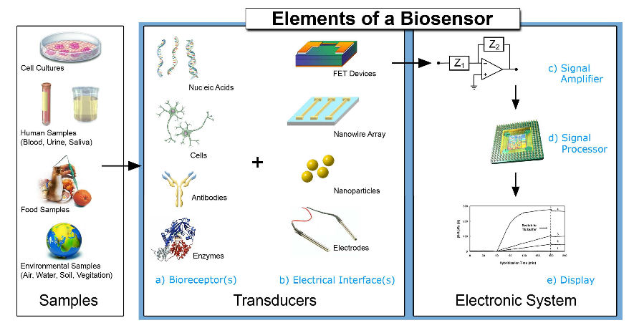

Slide 11
Microbial Electrochemical Biosensors
Microbial electrochemical biosensors are of three types:
Amperometric
Potentiometric
Conductometric

Slide 12
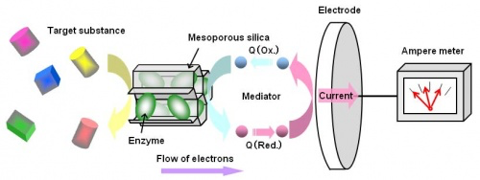
Amperometric Biosensors
Amperometric microbial biosensors work at a fixed potential with respect to the reference electrode and involves the detection of current generated by the oxidation or reduction of the species at the surface of the electrode.
Amperometric microbial biosensors have been developed for the estimation of biochemical oxygen demand (BOD) for the measurement of biodegradable organic matter.

Slide 13
Biochemical oxygen demand (BOD) is the amount of dissolved oxygen needed (i.e. demanded) by aerobic biological organisms to break down organic material present in a given water sample at certain temperature over a specific time period.
The BOD value is most commonly expressed in milligrams of oxygen consumed per litre of sample during 5 days of incubation at 20 °C and is often used as a surrogate of the degree of organic pollution of water.
BOD reduction is used as a gauge of the effectiveness of wastewater treatment plants.

Slide 14
Potentiometric Biosensors
The microbial potentiometric biosensor is developed using a conventional ion-selective electrode (pH, ammonium chloride, etc.) or a gas sensing electrode (pCO₂ and pNH₃) coated with an immobilized microbe layer.
The microorganisms consume the analyte thereby bringing a change in the potential resulting from ion accumulation or depletion.
The potentiometric transducers compare the change between the working electrode and the reference electrode, and the signal is correlated to the concentration of the analyte.

Slide 15
Potentiometric Biosensors

Slide 16
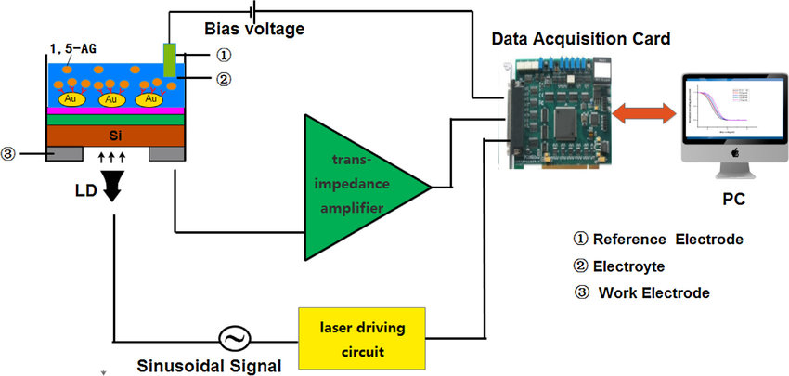
Light-addressable potentiometric sensor

Slide 17
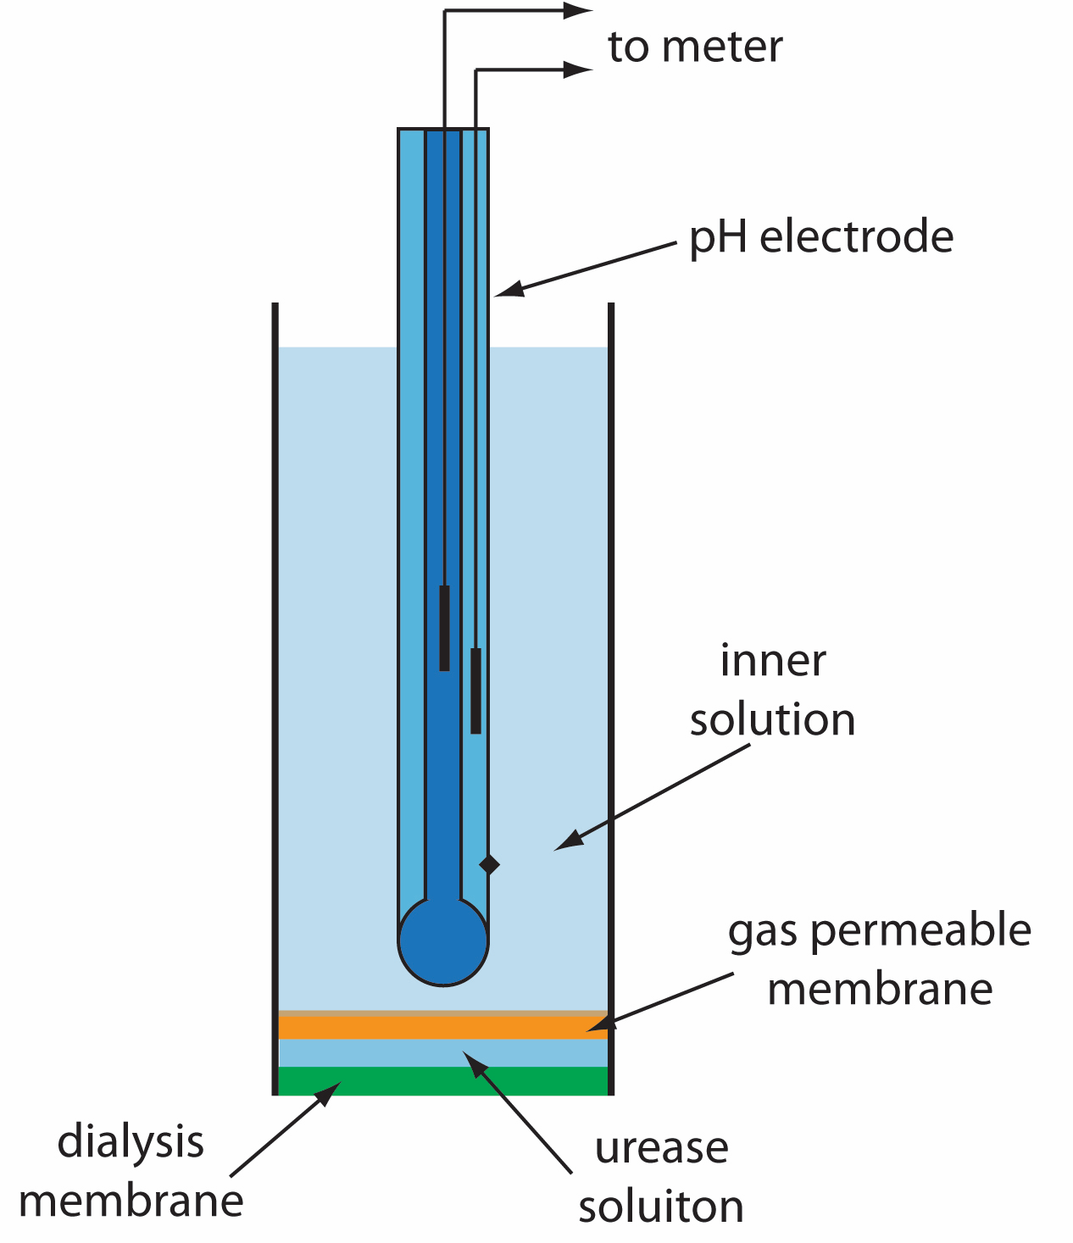
Potentiometric Biosensors

Slide 18
Conductometric Biosensors
Conductometry is a technique which measures conductivity changes in the solution due to the production or consumption of ionic species.
A majority of microbe-catalyzed reactions involved a change in the ionic species.

Slide 19
Optical microbial biosensors
Optical microbial biosensors are generally based on the changes in the optical properties brought by the interaction of the biocatalyst with the target analyte:
Some of the optical properties are:
Absorption (UV-Vis),
Bioluminescence
Chemiluminescence
Reflectance
Fluorescence
The advantages of optical biosensors are compactness, flexibility, resistance to electrical noise and small probe size.

Slide 20
Optical microbial biosensors Fluorescence Biosensor
Fluorescence spectroscopy is a sensitive analytical technique which can detect very low concentrations of the analyte.
There is a direct correlation between the fluorescence emission intensity and concentration at low analyte concentrations.
The fluorescent microbial biosensors have been divided into two broad categories based on the detection mode: in vivo and in vitro.
The in vivo fluorescent microbial sensor generally incorporates the use of a genetically engineered microorganism which is able to express a reporter gene encoding a protein.

Slide 21
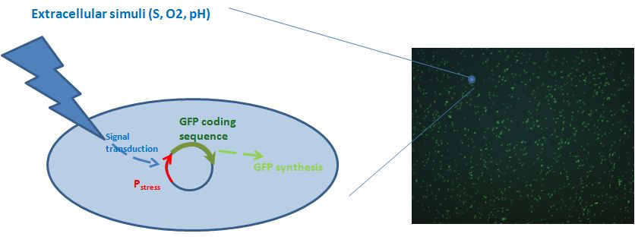
Optical microbial biosensors Fluorescence Biosensor
Green fluorescent protein (GFP) encoded by the gene gfp is the most popular tool due to its stability and sensitivity

Slide 22
Optical microbial biosensors Fluorescence Biosensor

Slide 23
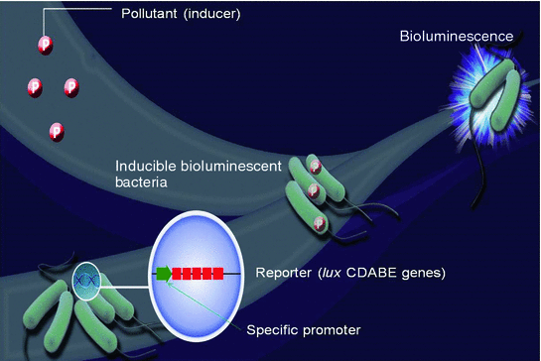
Optical microbial biosensors Bioluminescent Microbial Biosensor
The bioluminescent microbial biosensor measures the changes in luminosity of the living microorganisms

Slide 24
Optical microbial biosensors Bioluminescent Microbial Biosensor

